Slide 1



HANDOUT
STRUCTURED INTERDISCIPLINARY ROUNDS (SIDRs)
SIDRs: WHAT, WHY, and HOW
WHAT?
A daily multidisciplinary review of each patient’s status and care plan.
Attended by the patient and all members of the multidisciplinary team as appropriate.
Typically every morning Monday-Friday.
Consistent round times result in less waiting time for the patient and makes it easier for patient relatives to attend the rounds.
Duration depending on the complexity of the patients – up to 3-5 minutes per patient.
WHY?
Facilitate communication between all members of the multidisciplinary team
Create situational awareness about the patient and their circumstances
Enable collaborative decision making between members of the interdisciplinary teams and the patient
Reduce patient review times (Cornell et.al 2014), facilitating information to be shared among all disciplines
Reduce adverse events, particularly medication errors (O’Leary et.al 2011)
Reduce readmission rates (Townsend-Gervis et.al 2014)
Goals of the SIDR
> Exchange information
> Identify patient care plans and goals
> Determine discharge needs
> Generate task-list for interdisciplinary team members
> Problem solve difficult social or discharge issues
> Allow the patient to ask questions to all members of the interdisciplinary team
www.ucd.ie/collectiveleadership

Slide 2
HANDOUT
STRUCTURED INTERDISCIPLINARY ROUNDS (SIDRs)
HOW?
The MDT will review and communicate with and about each patient using a structured communication framework (ISDA, ISBAR or similar)
A facilitator might help facilitating closed loop communication and ensure the rounds are conducted within a reasonable time frame
Resources to help facilitate the SIDRs can be made, such as facilitator reference sheet and pocket cards (see back of page).
An Interdisciplinary Documentation Template, following the chosen communication framework, can be developed.
Can be stationary (e.g. a meeting room) or mobile depending on the ward/team requirement.
ISDA
> Identify the patient’s name, main diagnosis or reason for admission, anticipated discharge date and disposition
> Summarise the goals of care and treatment plan
> Discuss and interdisciplinary issues for daily cares and discharge planning
> Ask what was missed and what orders need to be placed
www.ucd.ie/collectiveleadership

Slide 3
HANDOUT
STRUCTURED INTERDISCIPLINARY ROUNDS (SIDRs)
Questions for group discussion
How might SIDRs benefit our patient care and daily work?
What challenges could we experience in implementing SIDRs in our daily work?
When, where and how often will our SIDRs take place?
Who will participate in the SIDRs?
How will SIDRs be run in our team?
  Choice of structured communication framework (ISDA/ISBAR/other?)
  Facilitator role?
How and when will we evaluate the SIDRs?
What support/materials would we need to implement the SIDRs? (e.g. pocket cards, posters outlining SIDR goals and/or the communication framework, etc.)
www.ucd.ie/collectiveleadership

Slide 4
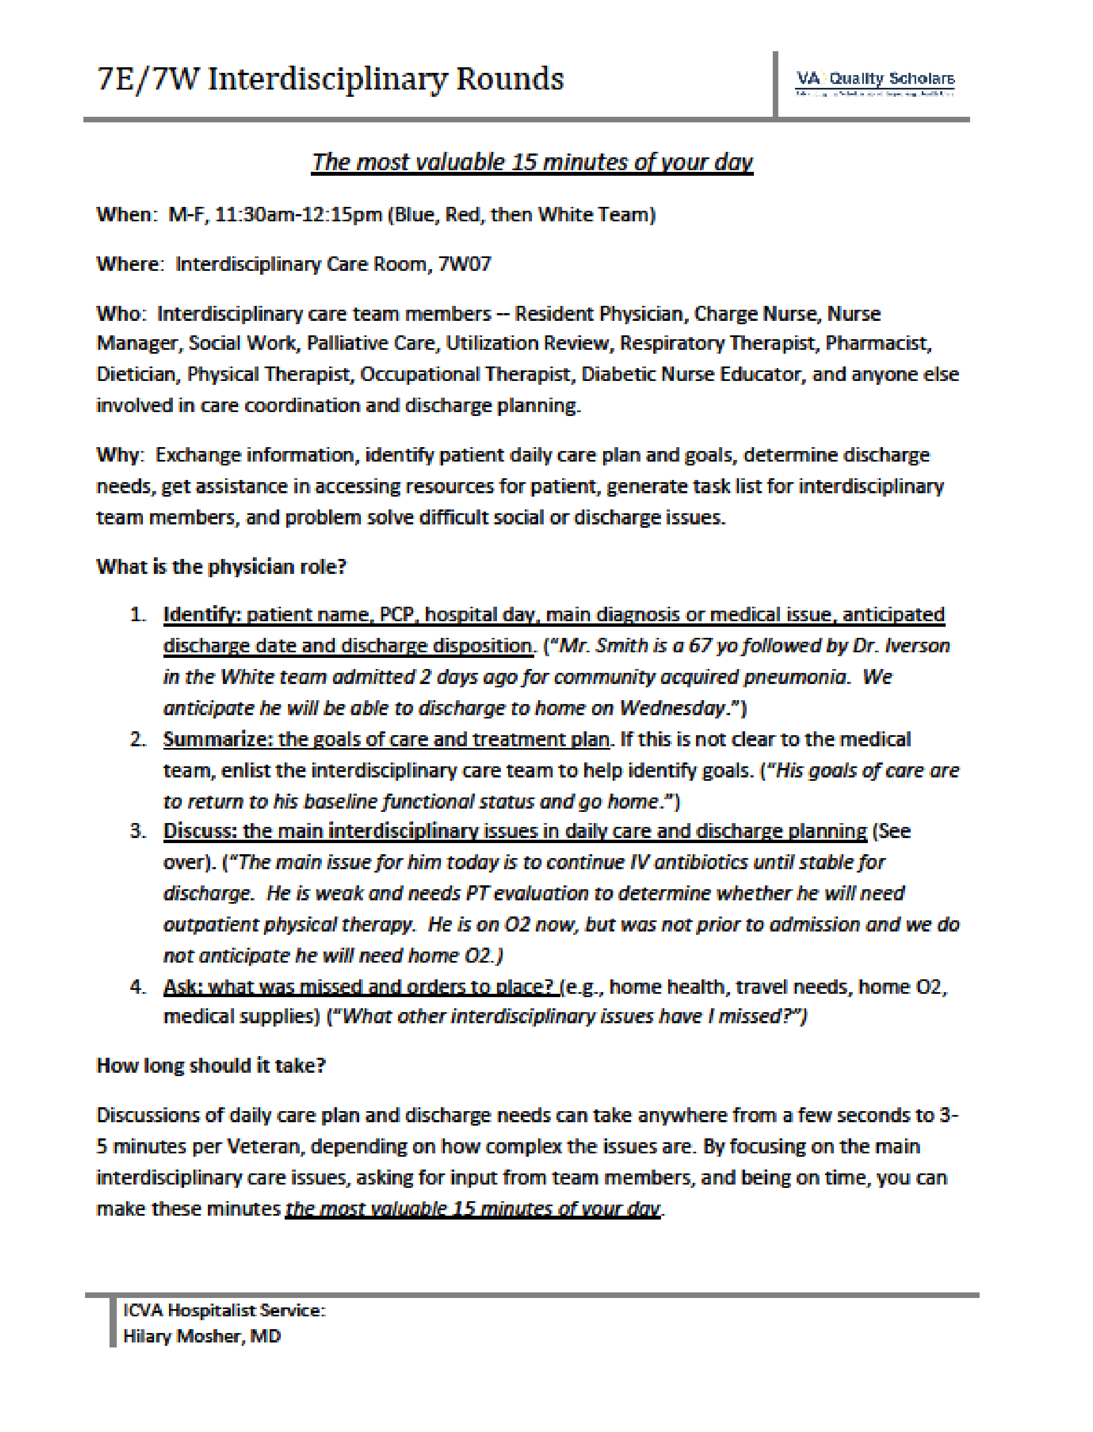
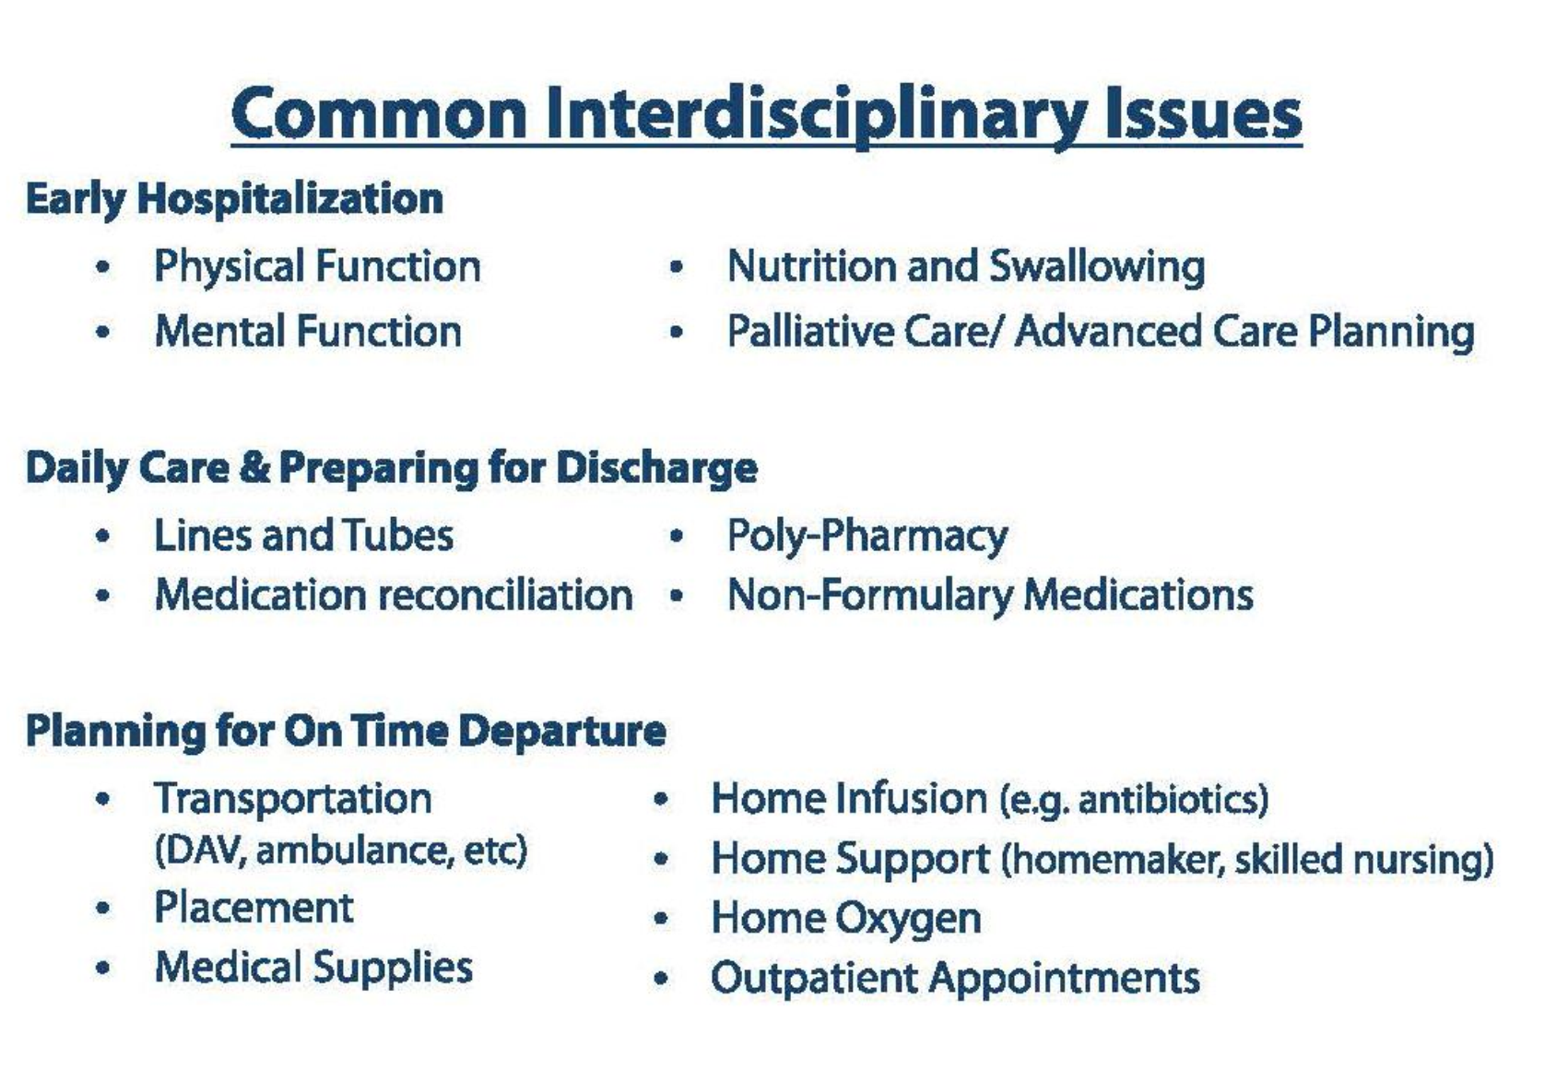
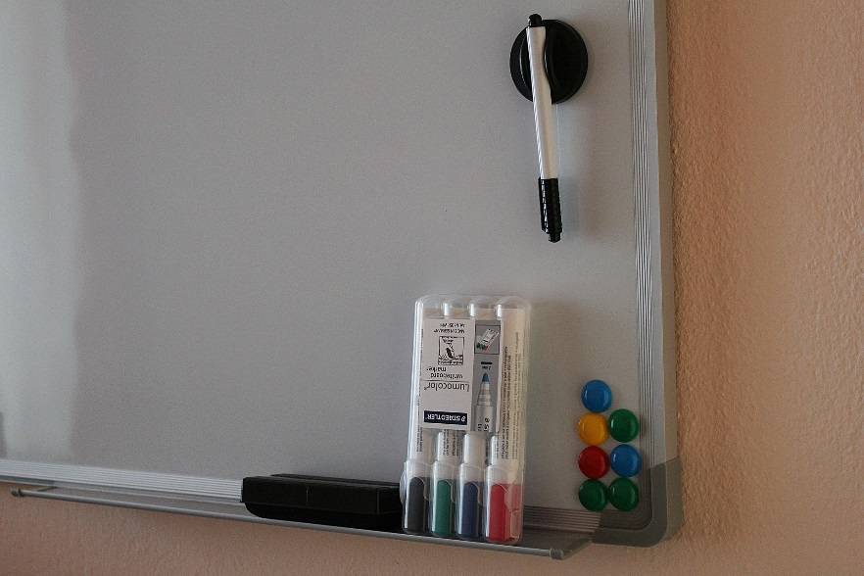
HANDOUT
STRUCTURED INTERDISCIPLINARY ROUNDS (SIDRs)
Example of a facilitator reference sheet and pocket card for use in Structured Interdisciplinary Rounds – from VA Quality Scholars (VAQS), available at https://www.cadre.research.va.gov/forms/IDRToolkit.pdf
Patient communication boards can assist the SIDRs: The patient and family can record questions for all or any members of the MDT ahead of the SIDRs, and the team can record collaborative goals and plans on the board.
www.ucd.ie/collectiveleadership

Slide 5


OUTCOMES TEMPLATE
STRUCTURED INTERDISCIPLINARY ROUNDS (SIDRs)
 | SUGGESTED AT THE INTERVENTION SESSION | SUBSEQUENT FOLLOW UP ON THE TEAM’S SUGGESTIONS
How might SIDRs benefit our patient care and daily work?
What challenges could we experience in implementing SIDRs in our daily work?
When, where and how often will the SIDRs take place?
Who will participate in the SIDRs?
How will SIDRs run in our team? e.g. choice of structured communication framework (ISDA / ISBAR / other?)
How and when will we evaluate the SIDRs?
What resources / materials would we need to implement the SIDRs? (e.g. pocket cards, facilitator reference cards)
www.ucd.ie/collectiveleadership

